Slide 1


Session 4: Functions and modules
Middlesex Computing Society: Python Programming
Arfa Kazi, Head of Python Programming

Slide 2

Last week’s recap
Grasp the idea of conditional statements and loops.
Understand the concepts of indentation, iteration and incrementation.
Learn how to use logical operators within conditionals.
Understand the structure and use of loops. Implement loops with complex data types.

Slide 3

This Week’s objectives:
Understand the definition and importance of functions.
Learn how to declare and call functions.
Understand the concept of parameters, return values and scope of variables.
Practice importing and using built-in modules.

Slide 4

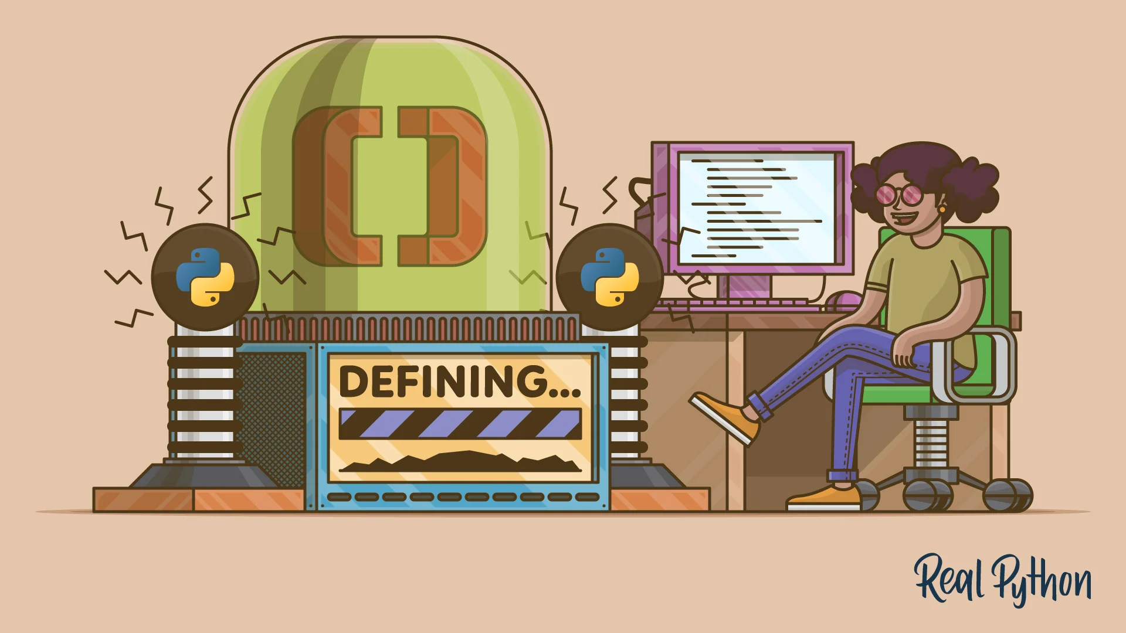
Introduction to functions
Definition: A function is a block of reusable code that performs a specific task.
Benefits: Code reusability, modularity, and readability.
Syntax:
def function_name(parameters):
# code block
return result # if needed

Slide 5
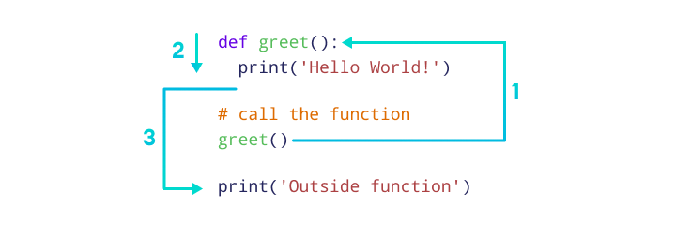
Defining and calling fucntions
Defining a Function:
def print_world():
print(“Hello World”)
Calling a Function:
printWorld()

Slide 6
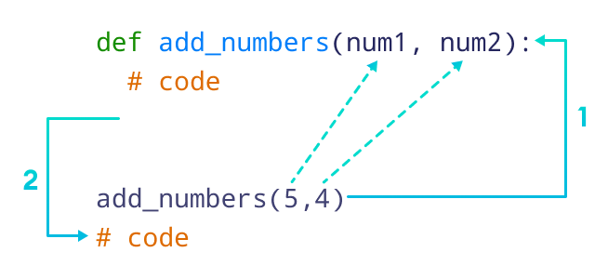
Function parameters and arguments
Parameters: Variables listed inside the parentheses in the function definition.
Arguments: Values passed to the function when it is called.
EXAMPLE:-
def add(a, b): # a and b are parameters
return a + b
result = add(3, 4) # 3 and 4 are arguments
print(result) # Output: 7

Slide 7
Keyword Arguments
Keyword arguments allow you to specify argument values by their parameter names when calling a function.
Advantages:
Improves code readability and clarity.
Allows arguments to be passed in any order.
Example:-
def greet(name, message="Hello"): #default message is “Hello”
print(message, name)
greet(name="Alice", message="Hi") # call with both arguments specified
greet(message="Hey", name="Bob") # function call in another order
greet("Charlie") # function call without message

Slide 8
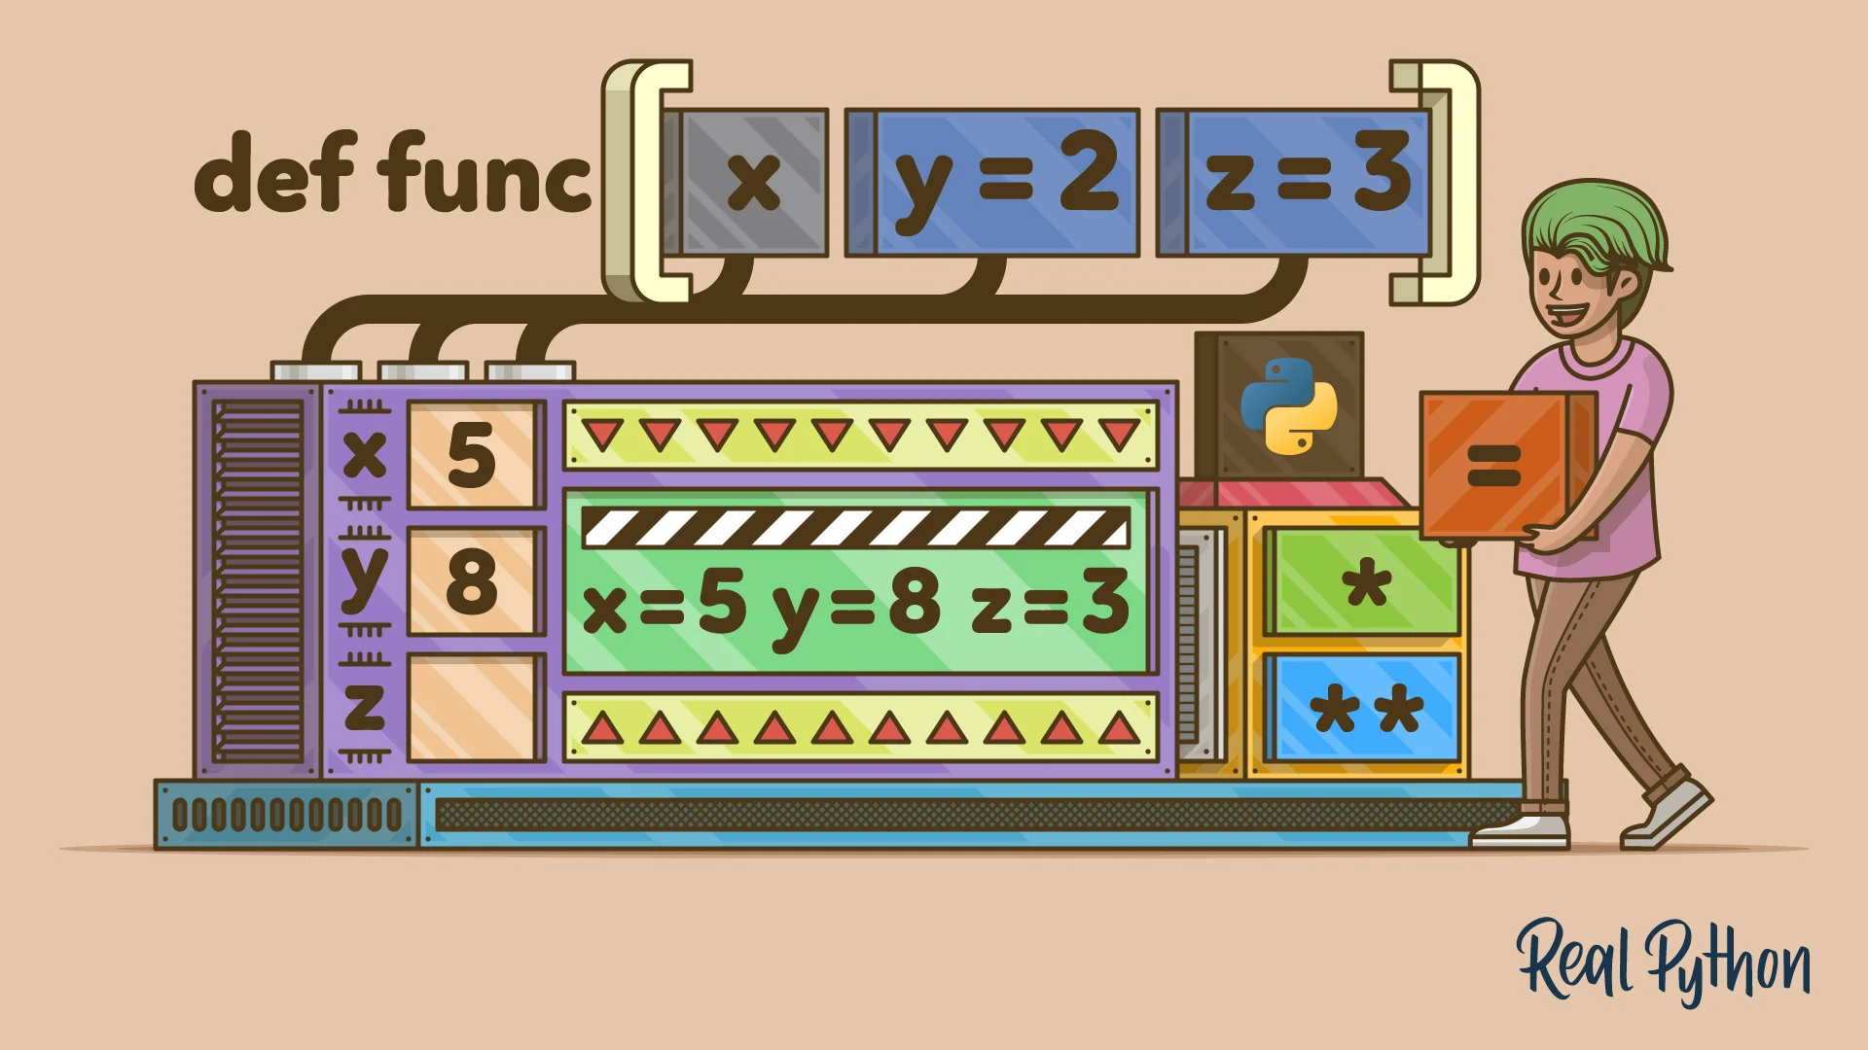
Arbitrary arguments
Definition: Arbitrary arguments allow a function to accept an indefinite number of arguments.
Useful when you do not know in advance how many arguments will be passed to the function.
Syntax: Use * before a parameter name (e.g., *args).
Eg:-
def greet(*names):
for name in names:
print("Hello, " + name + "!")
greet("Alice", "Bob", "Charlie")

Slide 9
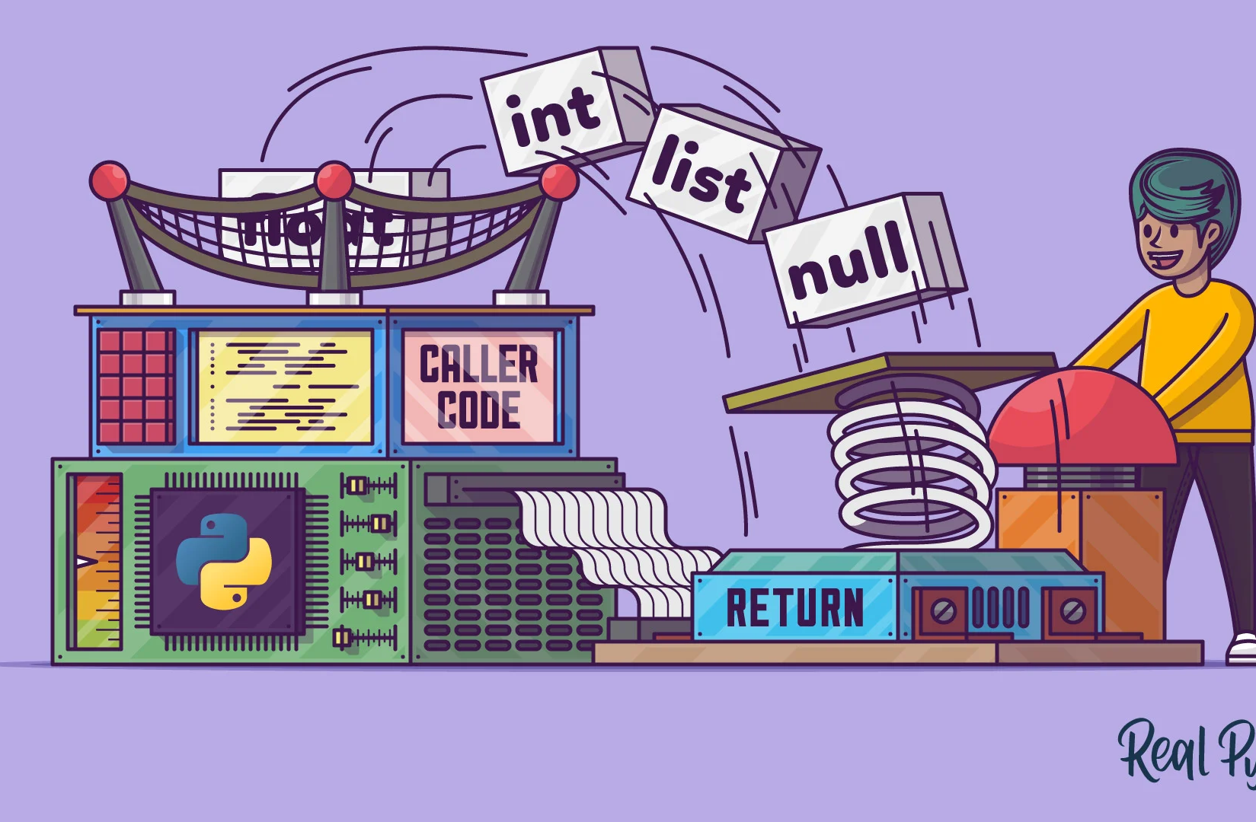
Return statement
Definition: The return statement ends the function execution and specifies a value to be returned to the caller.
Example:-
def square(x):
return x * x
result = square(5)
print(result) # Output: 25

Slide 10
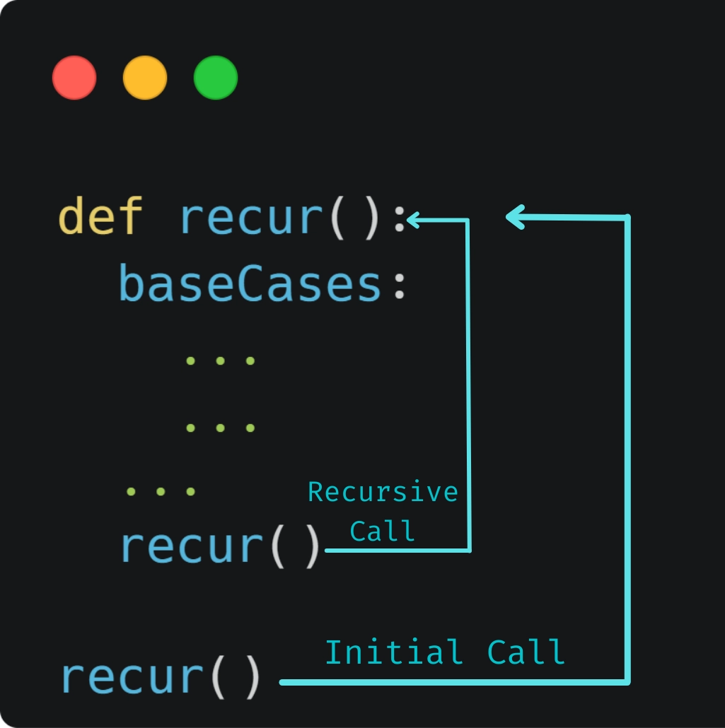
Recursion
Definition: Recursion is a programming technique where a function calls itself in order to solve a problem.
Key Concepts:
Base Case: The condition under which the recursive function stops calling itself.
Recursive Case: The part of the function where it calls itself.
Simplifies code for problems that have a repetitive or nested structure.
Commonly used in algorithms involving trees, graphs, and divide-and-conquer strategies.

Slide 11
Example of Recursion - Factorial
Denoted as n!, e.g., 5! = 5 * 4 * 3 * 2 * 1 = 120.
The factorial of a non-negative integer n is the product of all positive integers less than or equal to n.
Code:
def factorial(n):
if n == 0 or n == 1: # Base Case
return 1
else: # Recursive Case
return n * factorial(n - 1)
print(factorial(5)) # Output: 120

Slide 12

Introduction to modules
Definition: A module is a file containing Python definitions and statements.
Benefits: Organizes code into manageable sections, promotes code reuse.
Syntax:
import module_name
You can also import it with alias names.
import numpy as np
print(np.array([1, 2, 3]))

Slide 13
Standard modules
Standard modules are built-in modules that come with the Python Standard Library.
These modules are included with the default Python installation and do not require any additional installation steps.
Examples of Standard Modules:
os: Provides functions for interacting with the operating system.
math: Offers mathematical functions like trigonometry, logarithms, and more.
datetime: Supplies classes for manipulating dates and times.
random: Implements pseudo-random number generators for various distributions.

Slide 14

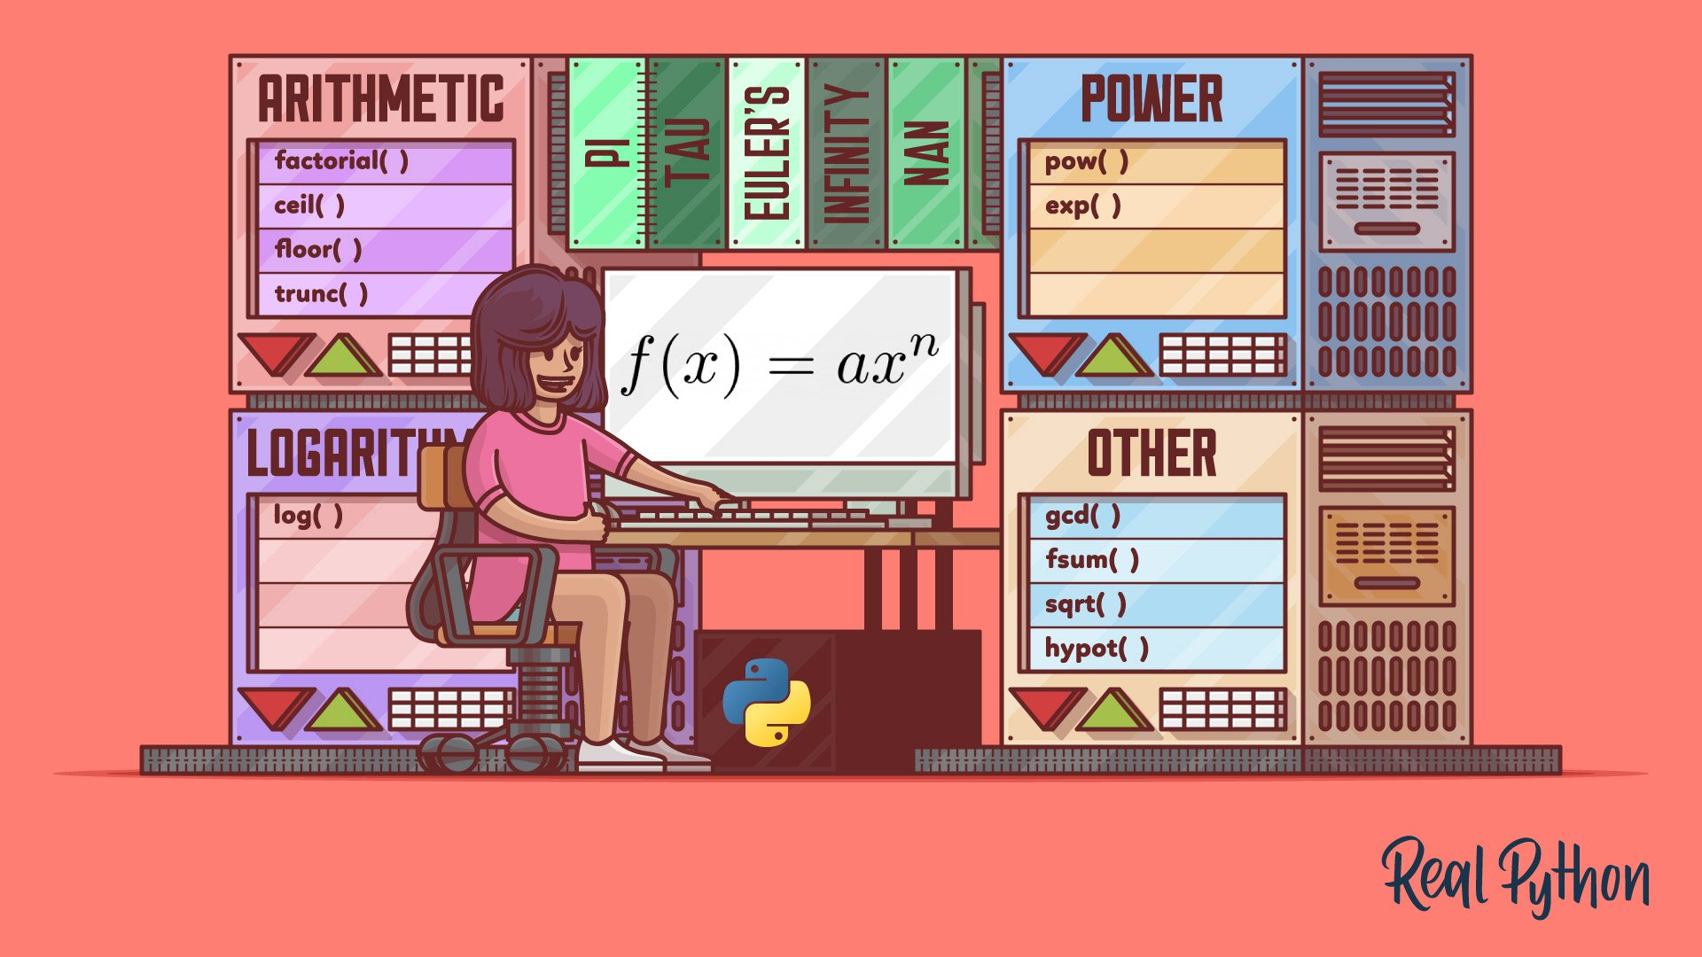
Math module
Overview:The math module provides access to mathematical functions defined by the C standard.
Commonly Used Functions:
math.sqrt(x): Returns the square root of x.
math.pow(x, y): Returns x raised to the power of y.
math.factorial(x): Returns the factorial of x.
math.sin(x), math.cos(x), math.tan(x): Trigonometric functions.
math.pi: The mathematical constant π (3.14159...).
https://docs.python.org/3/library/math.html

Slide 15
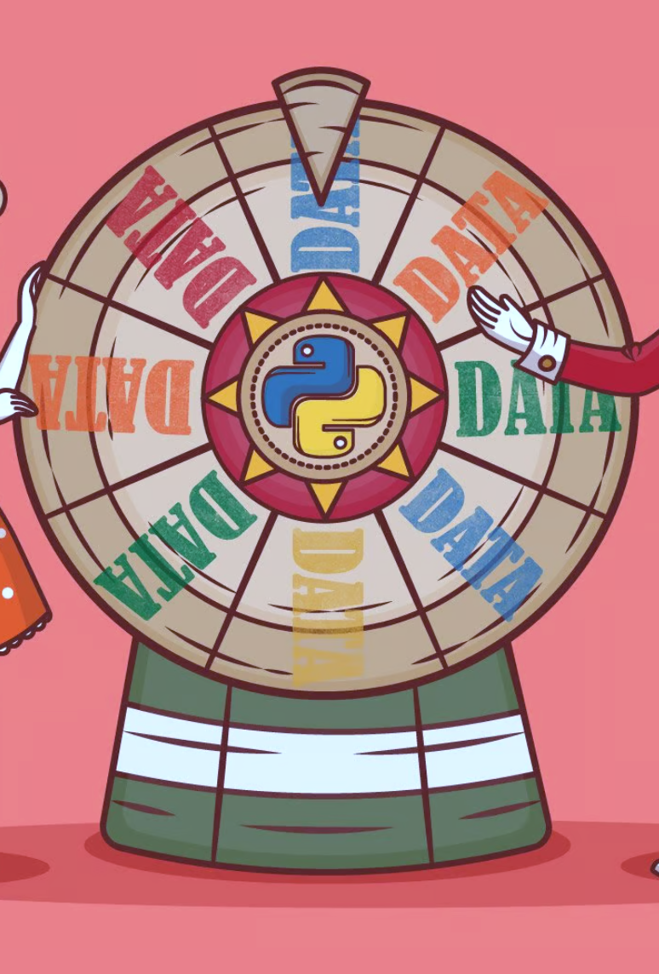
Random Module
Overview:The random module implements pseudo-random number generators for various distributions.
Commonly Used Functions:
random.random(): Returns a random float in the range [0.0, 1.0).
random.randint(a, b): Returns a random integer between a and b (inclusive).
random.choice(seq): Returns a random element from the non-empty sequence seq.
random.shuffle(seq): Shuffles the sequence seq in place.
https://docs.python.org/3/library/random.html

Slide 16
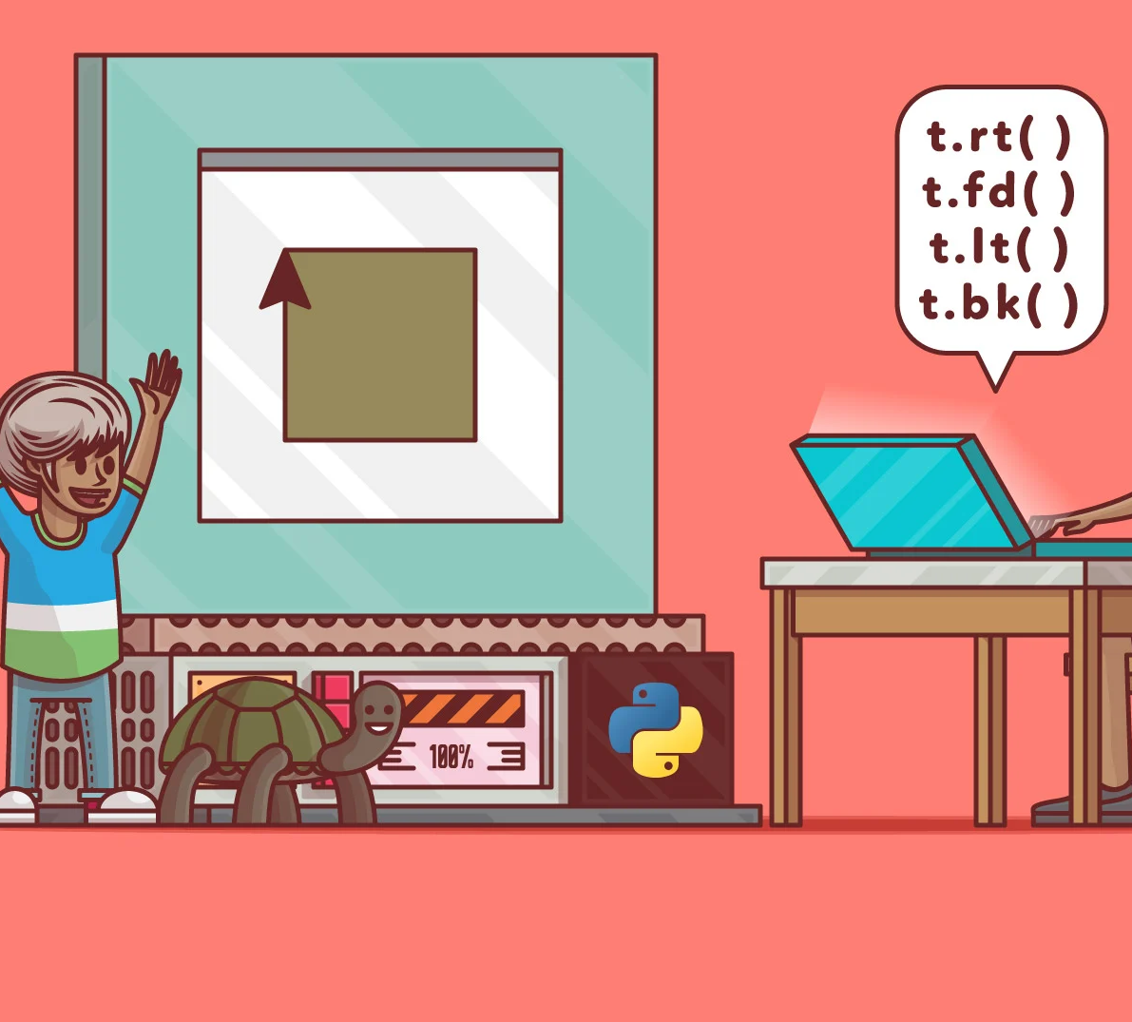
Turtle module
The turtle is a module within the Python Standard Library. It provides a way to create graphics and drawings programmatically.
Example:
import turtle
screen = turtle.Screen() #create a screen to display the graphics
t = turtle.Turtle() #create the “turtle” (brush)
t.forward(100) #move the “turtle”
t.left(90)
t.forward(100)
screen.mainloop()

Slide 17
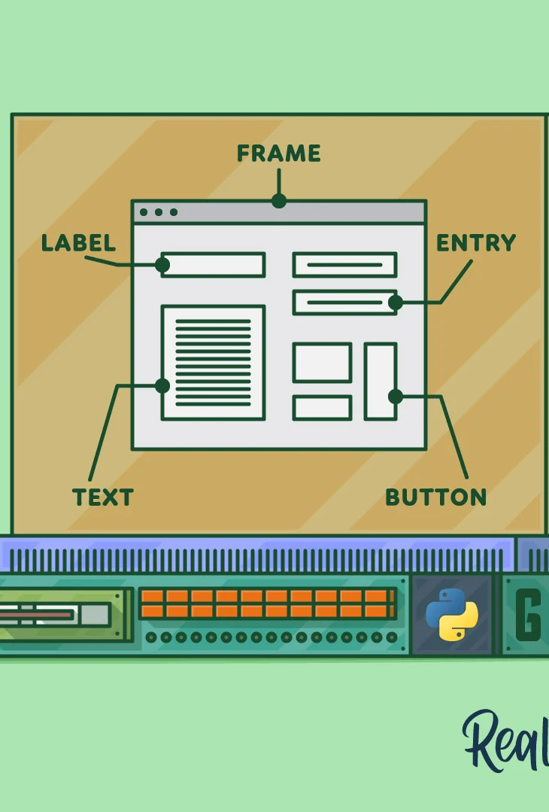
Tkinter module (requested)
A module in Python's standard library used to creating graphical user interfaces (GUIs).
Key Features:
Provides tools to create windows, dialogs, buttons, menus, and other GUI elements.
Cross-platform compatibility: works on Windows, macOS, and Linux.
Easy to use for creating simple to moderately complex GUI applications.
Example:-
import tkinter as tk
root = tk.Tk()
root.title("Simple Tkinter Window")
label = tk.Label(root, text="Hello, Tkinter!")
label.pack()
root.mainloop()

Slide 18
Third party modules
Third-party modules are additional modules created by the Python community or organizations that are not included in the Python Standard Library.
These modules need to be installed separately, typically using package managers like pip.
Examples of Popular Third-Party Modules:
NumPy: Fundamental package for scientific computing with Python.
Pandas: Powerful data structures for data analysis and manipulation.
Requests: Simple, yet elegant HTTP library for Python.
BeautifulSoup: Library for parsing HTML and XML documents.
TensorFlow: Open-source platform for machine learning.

Slide 19

PyGame (requested)
PyGame is a set of Python modules designed for writing video games.
It includes computer graphics and sound libraries to create games and multimedia applications. Supports 2D graphics, sound, and music.
Run the following command to install PyGame:
pip install pygame
To use pygame in your program.
import pygame

Slide 20
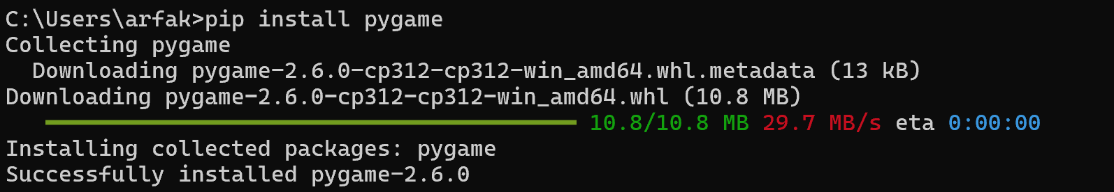

Slide 21
Module vs package vs library vs framework
A module is a single file (or files) that contains Python code, such as functions, classes, or variables. Eg:- math, random, os
A package is a directory of Python modules, including an __init__.py file to treat the directory as a package.
A library is a collection of modules that are grouped together. It may include multiple modules and packages. Eg:- NumPy, Pandas, Requests.
A framework is a comprehensive toolset and structure for building and deploying applications, dictating the architecture and workflow. Eg:- Django

Slide 22
Mini Test
Get all correct for a Prize!!
https://docs.google.com/forms/d/e/1FAIpQLSf4eqhKknAAByfz3b0BrrLvHz-XxKs9TtT_33AwEJmAvNHtXg/viewform?usp=sf_link

Slide 23
Additional Resources
Cisco Python Essentials 1 https://skillsforall.com/course/python-essentials-1?courseLang=en-US
https://realpython.com/
https://www.w3schools.com/python/python_functions.asp
https://www.geeksforgeeks.org/python-programming-language-tutorial/

Slide 24
Preview of Next Week!!
Understand the principles of Object-Oriented Programming (OOP).
Learn how to define and create classes and objects.
Understand and implement class attributes and methods.
Explore the concepts of inheritance, polymorphism,encapsulation, and abstraction.

Slide 25

THANK YOU FOR STICKING TILL THE END!!!
Here is Another Special Easter Egg in Python
import this
love = this
this is love
love is True
love is False
love is not True or False
love is not True or False; love is love # FML
Try it in your Python interpreter and see the result!

Slide 26
